Slide 1

EDA : Bank Loan Default Risk Analysis
Soumyajit Behera

Slide 2
Table of Contents:
Introduction
Getting Jupyter Ready
Reading & Understanding the data
Data Cleaning & Manipulation
Data Analysis
Merged Dataframes Analysis
Conclusions

Slide 3
1.Introduction:
This case study aims to give an idea of applying EDA in a real business scenario. In this case study, we will develop a basic understanding of risk analytics in banking and financial services and understand how data is used to minimise the risk of losing money while lending to customers.

Slide 4
Business Understanding and Objective:
The loan providing companies find it hard to give loans to the people due to their insufficient or non-existent credit history. Because of that, some consumers use it as their advantage by becoming a defaulter.
When the company receives a loan application, the company has to decide for loan approval based on the applicant’s profile. Two types of risks are associated with the bank’s decision:
If the applicant is likely to repay the loan, then not approving the loan results in a loss of business to the company.
If the applicant is not likely to repay the loan, i.e. he/she is likely to default, then approving the loan may lead to a financial loss for the company.
This case study aims to identify patterns which indicate if a client has difficulty paying their installments which may be used for taking actions such as denying the loan, reducing the amount of loan, lending (to risky applicants) at a higher interest rate, etc. This will ensure that the consumers capable of repaying the loan are not rejected. Identification of such applicants using EDA is the aim of this case study.

Slide 5
2. Getting Jupyter Ready:
Import Python Libraries:
import numpy as np
import pandas as pd
import matplotlib.pyplot as plt
import seaborn as sns
%matplotlib inline
Supress Warnings:
import warnings
warnings.filterwarnings('ignore’)
Adjust jupiter views:
pd.set_option('display.max_rows',500)
pd.set_option('display.max_columns',500)
pd.set_option('display.width',1000)
pd.set_option('display.expand_frame_repr',False)

Slide 6
3. Reading & Understanding the data:
Importing csv file:
applicationDF = pd.read_csv(r"D:\EDA_rev\EDA Bank Default Analysis\application_data.csv\application_data.csv")
previousDF = pd.read_csv(r"D:\EDA_rev\EDA Bank Default Analysis\previous_application.csv\previous_application.csv")

Slide 7
Database column types (applicationDF):
<class 'pandas.core.frame.DataFrame'>
RangeIndex: 307511 entries, 0 to 307510
Data columns (total 122 columns):
# Column Dtype
--- ------ -----
0 SK_ID_CURR int64
1 TARGET int64
2 NAME_CONTRACT_TYPE object
3 CODE_GENDER object
4 FLAG_OWN_CAR object
5 FLAG_OWN_REALTY object
6 CNT_CHILDREN int64
7 AMT_INCOME_TOTAL float64
8 AMT_CREDIT float64
9 AMT_ANNUITY float64
10 AMT_GOODS_PRICE float64
11 NAME_TYPE_SUITE object
12 NAME_INCOME_TYPE object
13 NAME_EDUCATION_TYPE object
14 NAME_FAMILY_STATUS object
15 NAME_HOUSING_TYPE object
16 REGION_POPULATION_RELATIVE float64
17 DAYS_BIRTH int64
18 DAYS_EMPLOYED int64
19 DAYS_REGISTRATION float64
20 DAYS_ID_PUBLISH int64
21 OWN_CAR_AGE float64
22 FLAG_MOBIL int64
23 FLAG_EMP_PHONE int64
24 FLAG_WORK_PHONE int64
25 FLAG_CONT_MOBILE int64
26 FLAG_PHONE int64
27 FLAG_EMAIL int64
28 OCCUPATION_TYPE object
29 CNT_FAM_MEMBERS float64
30 REGION_RATING_CLIENT int64
31 REGION_RATING_CLIENT_W_CITY int64
32 WEEKDAY_APPR_PROCESS_START object
33 HOUR_APPR_PROCESS_START int64
34 REG_REGION_NOT_LIVE_REGION int64
35 REG_REGION_NOT_WORK_REGION int64
36 LIVE_REGION_NOT_WORK_REGION int64
37 REG_CITY_NOT_LIVE_CITY int64
38 REG_CITY_NOT_WORK_CITY int64
39 LIVE_CITY_NOT_WORK_CITY int64
40 ORGANIZATION_TYPE object
41 EXT_SOURCE_1 float64
42 EXT_SOURCE_2 float64
43 EXT_SOURCE_3 float64
44 APARTMENTS_AVG float64
45 BASEMENTAREA_AVG float64
46 YEARS_BEGINEXPLUATATION_AVG float64
47 YEARS_BUILD_AVG float64
48 COMMONAREA_AVG float64
49 ELEVATORS_AVG float64
50 ENTRANCES_AVG float64
51 FLOORSMAX_AVG float64
52 FLOORSMIN_AVG float64
53 LANDAREA_AVG float64
54 LIVINGAPARTMENTS_AVG float64
55 LIVINGAREA_AVG float64
56 NONLIVINGAPARTMENTS_AVG float64
57 NONLIVINGAREA_AVG float64
58 APARTMENTS_MODE float64
59 BASEMENTAREA_MODE float64
60 YEARS_BEGINEXPLUATATION_MODE float64
61 YEARS_BUILD_MODE float64
62 COMMONAREA_MODE float64
63 ELEVATORS_MODE float64
64 ENTRANCES_MODE float64
65 FLOORSMAX_MODE float64
66 FLOORSMIN_MODE float64
67 LANDAREA_MODE float64
68 LIVINGAPARTMENTS_MODE float64
69 LIVINGAREA_MODE float64
70 NONLIVINGAPARTMENTS_MODE float64
71 NONLIVINGAREA_MODE float64
72 APARTMENTS_MEDI float64
73 BASEMENTAREA_MEDI float64
74 YEARS_BEGINEXPLUATATION_MEDI float64
75 YEARS_BUILD_MEDI float64
76 COMMONAREA_MEDI float64
77 ELEVATORS_MEDI float64
78 ENTRANCES_MEDI float64
79 FLOORSMAX_MEDI float64
80 FLOORSMIN_MEDI float64
81 LANDAREA_MEDI float64
82 LIVINGAPARTMENTS_MEDI float64
83 LIVINGAREA_MEDI float64
84 NONLIVINGAPARTMENTS_MEDI float64
85 NONLIVINGAREA_MEDI float64
86 FONDKAPREMONT_MODE object
87 HOUSETYPE_MODE object
88 TOTALAREA_MODE float64
89 WALLSMATERIAL_MODE object
90 EMERGENCYSTATE_MODE object
91 OBS_30_CNT_SOCIAL_CIRCLE float64
92 DEF_30_CNT_SOCIAL_CIRCLE float64
93 OBS_60_CNT_SOCIAL_CIRCLE float64
94 DEF_60_CNT_SOCIAL_CIRCLE float64
95 DAYS_LAST_PHONE_CHANGE float64
96 FLAG_DOCUMENT_2 int64
97 FLAG_DOCUMENT_3 int64
98 FLAG_DOCUMENT_4 int64
99 FLAG_DOCUMENT_5 int64
100 FLAG_DOCUMENT_6 int64
101 FLAG_DOCUMENT_7 int64
102 FLAG_DOCUMENT_8 int64
103 FLAG_DOCUMENT_9 int64
104 FLAG_DOCUMENT_10 int64
105 FLAG_DOCUMENT_11 int64
106 FLAG_DOCUMENT_12 int64
107 FLAG_DOCUMENT_13 int64
108 FLAG_DOCUMENT_14 int64
109 FLAG_DOCUMENT_15 int64
110 FLAG_DOCUMENT_16 int64
111 FLAG_DOCUMENT_17 int64
112 FLAG_DOCUMENT_18 int64
113 FLAG_DOCUMENT_19 int64
114 FLAG_DOCUMENT_20 int64
115 FLAG_DOCUMENT_21 int64
116 AMT_REQ_CREDIT_BUREAU_HOUR float64
117 AMT_REQ_CREDIT_BUREAU_DAY float64
118 AMT_REQ_CREDIT_BUREAU_WEEK float64
119 AMT_REQ_CREDIT_BUREAU_MON float64
120 AMT_REQ_CREDIT_BUREAU_QRT float64
121 AMT_REQ_CREDIT_BUREAU_YEAR float64
dtypes: float64(65), int64(41), object(16)
memory usage: 286.2+ MB

Slide 8
Database column types (previousDF):
<class 'pandas.core.frame.DataFrame'>
RangeIndex: 1670214 entries, 0 to 1670213
Data columns (total 37 columns):
# Column Non-Null Count Dtype
--- ------ -------------- -----
0 SK_ID_PREV 1670214 non-null int64
1 SK_ID_CURR 1670214 non-null int64
2 NAME_CONTRACT_TYPE 1670214 non-null object
3 AMT_ANNUITY 1297979 non-null float64
4 AMT_APPLICATION 1670214 non-null float64
5 AMT_CREDIT 1670213 non-null float64
6 AMT_DOWN_PAYMENT 774370 non-null float64
7 AMT_GOODS_PRICE 1284699 non-null float64
8 WEEKDAY_APPR_PROCESS_START 1670214 non-null object
9 HOUR_APPR_PROCESS_START 1670214 non-null int64
10 FLAG_LAST_APPL_PER_CONTRACT 1670214 non-null object
11 NFLAG_LAST_APPL_IN_DAY 1670214 non-null int64
12 RATE_DOWN_PAYMENT 774370 non-null float64
13 RATE_INTEREST_PRIMARY 5951 non-null float64
14 RATE_INTEREST_PRIVILEGED 5951 non-null float64
15 NAME_CASH_LOAN_PURPOSE 1670214 non-null object
16 NAME_CONTRACT_STATUS 1670214 non-null object
17 DAYS_DECISION 1670214 non-null int64
18 NAME_PAYMENT_TYPE 1670214 non-null object
19 CODE_REJECT_REASON 1670214 non-null object
20 NAME_TYPE_SUITE 849809 non-null object
21 NAME_CLIENT_TYPE 1670214 non-null object
22 NAME_GOODS_CATEGORY 1670214 non-null object
23 NAME_PORTFOLIO 1670214 non-null object
24 NAME_PRODUCT_TYPE 1670214 non-null object
25 CHANNEL_TYPE 1670214 non-null object
26 SELLERPLACE_AREA 1670214 non-null int64
27 NAME_SELLER_INDUSTRY 1670214 non-null object
28 CNT_PAYMENT 1297984 non-null float64
29 NAME_YIELD_GROUP 1670214 non-null object
30 PRODUCT_COMBINATION 1669868 non-null object
31 DAYS_FIRST_DRAWING 997149 non-null float64
32 DAYS_FIRST_DUE 997149 non-null float64
33 DAYS_LAST_DUE_1ST_VERSION 997149 non-null float64
34 DAYS_LAST_DUE 997149 non-null float64
35 DAYS_TERMINATION 997149 non-null float64
36 NFLAG_INSURED_ON_APPROVAL 997149 non-null float64
dtypes: float64(15), int64(6), object(16)
memory usage: 471.5+ MB

Slide 9
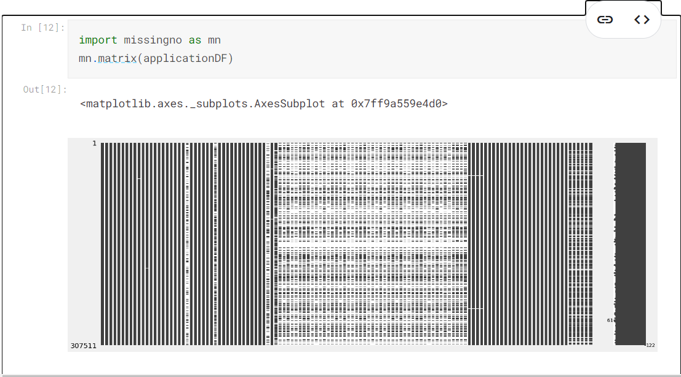
4. Data Cleaning & Manipulation : 4.1 Null Value Calculation : 4.1.1 applicationDF Missing values

Slide 10
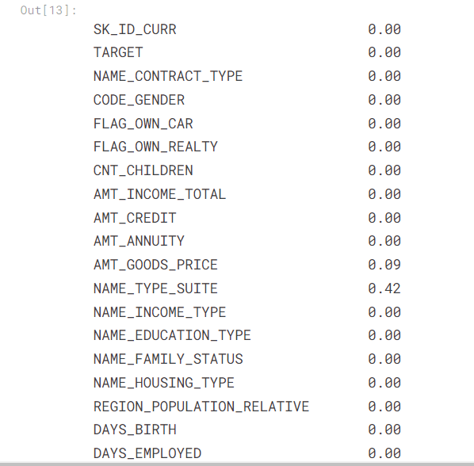
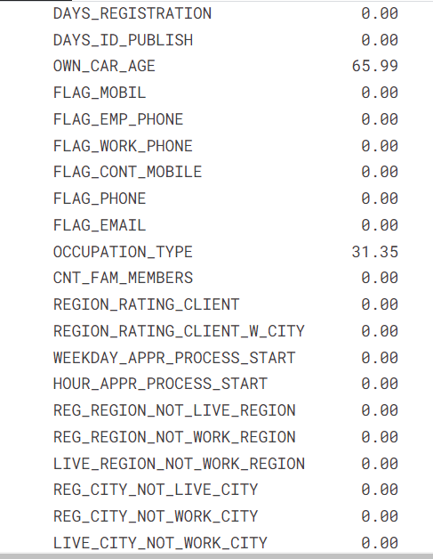
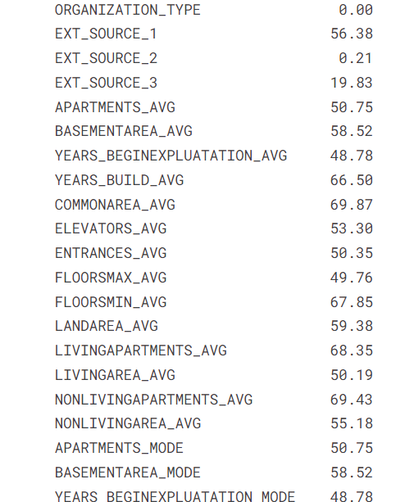
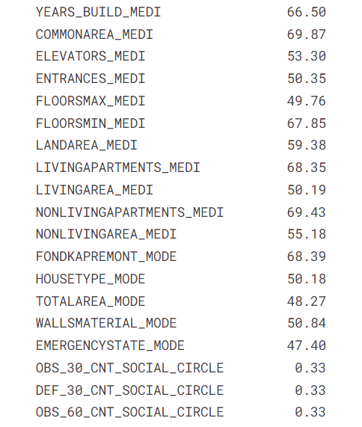
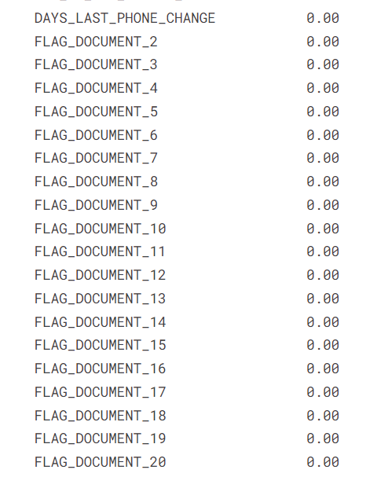
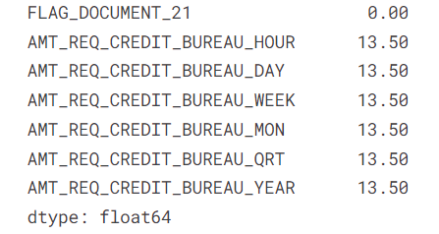
Insight: Based on the above Matrix, it is evidednt that the dataset has many missing values. Let's check for each column what is the % of missing values
There are many columns in applicationDF dataframe where missing value is more than 40%. Let's plot the columns vs missing value % with 40% being the cut-off marks

Slide 11
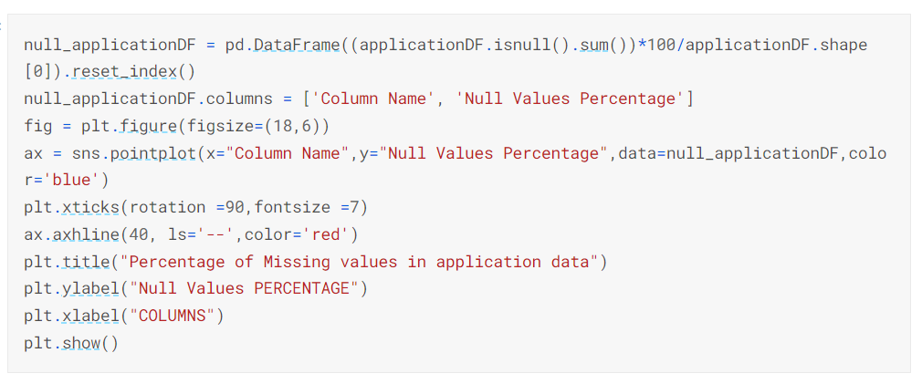
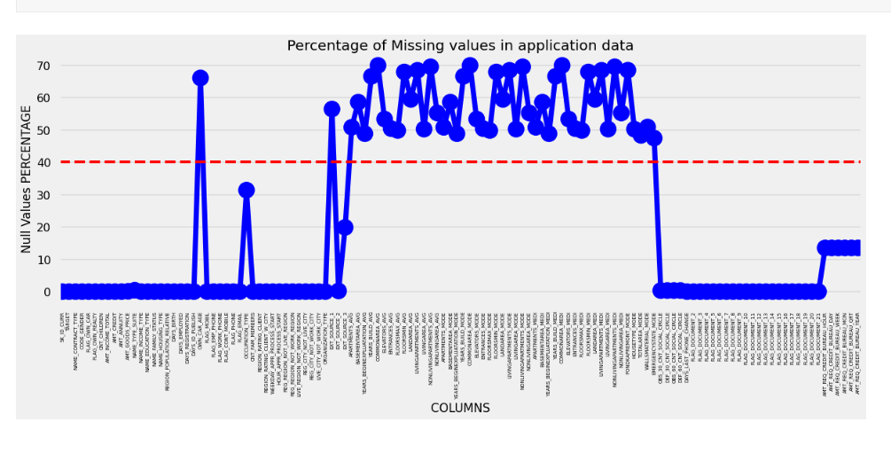
Insight:
From the plot we can see the columns in which percentage of null values more than 40% are marked above the red line and the columns which have less than 40 % null values below the red line. Let's check the columns which has more than 40% missing values.

Slide 12
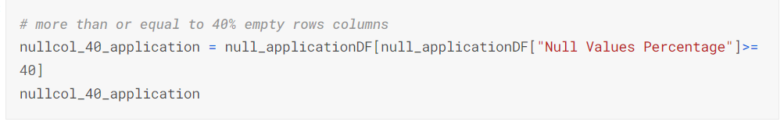
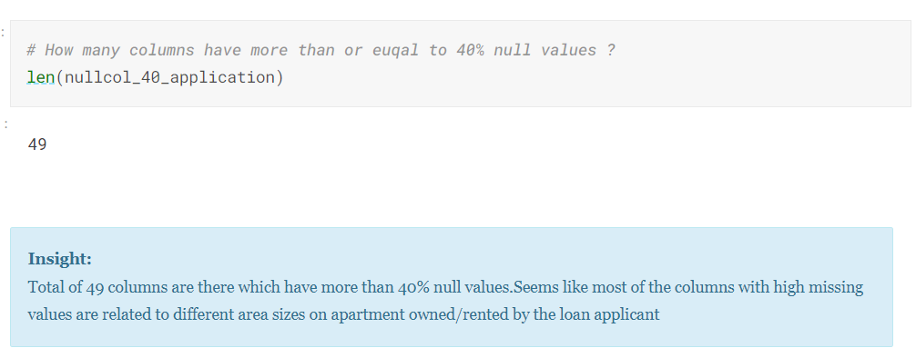

Slide 13
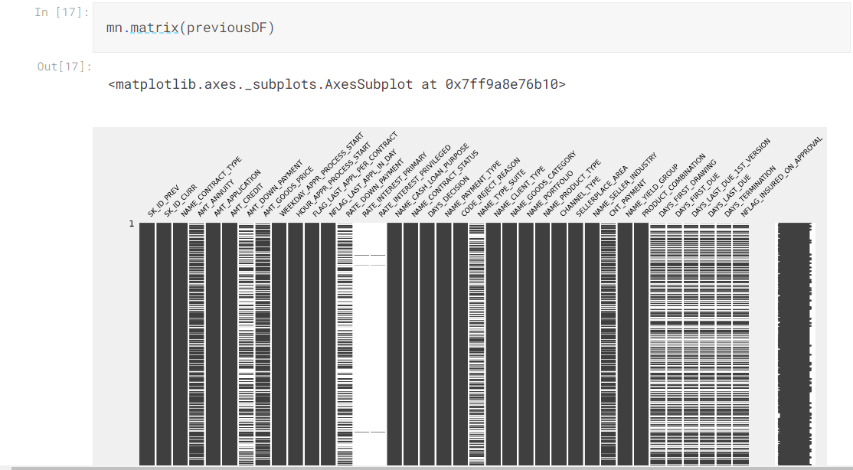
4.1.2 previousDF Missing Values:

Slide 14
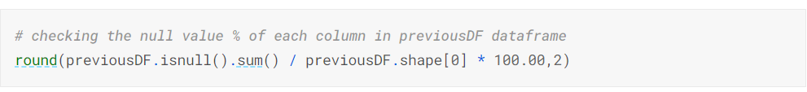
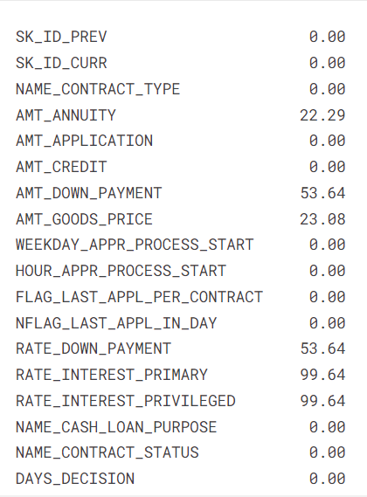
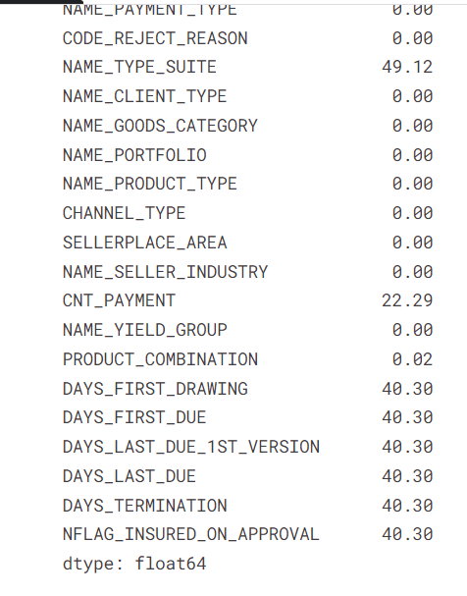
Insight: There are many columns in previousDF dataframe where missing value is more than 40%. Let's plot the columns vs missing value % with 40% being the cut-off marks

Slide 15
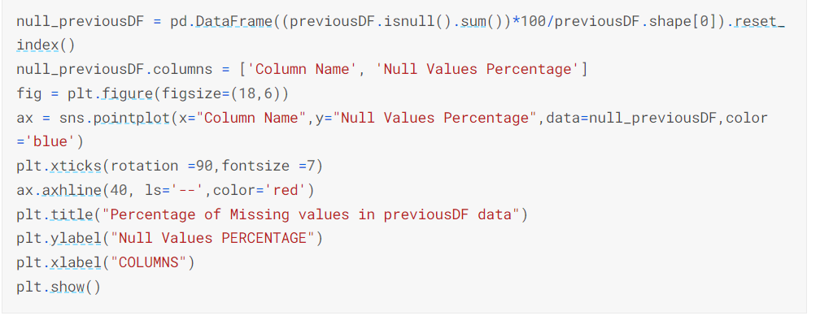
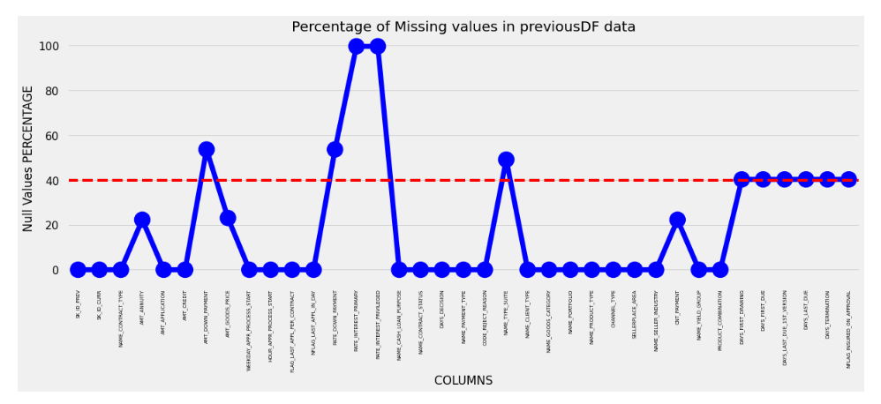
Insight: From the plot we can see the columns in which percentage of null values more than 40% are marked above the red line and the columns which have less than 40 % null values below the red line. Let's check the columns which has more than 40% missing values

Slide 16
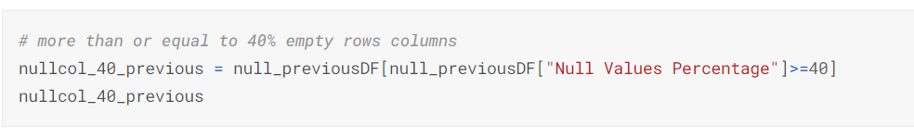
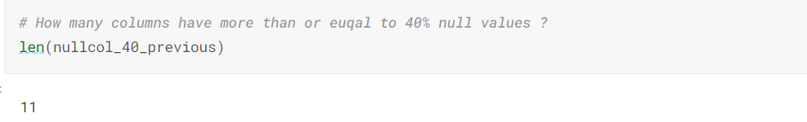
Insight: Total of 11 columns are there which have more than 40% null values. These columns can be deleted.

Slide 17
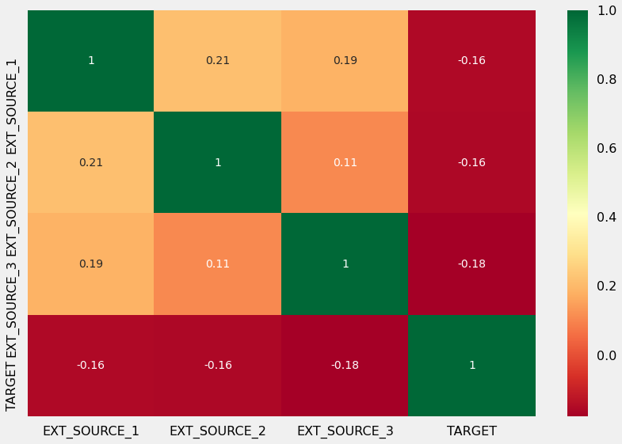
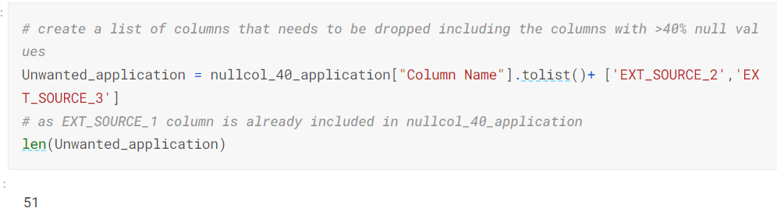
4.2 Analyze & Delete Unnecessary Columns in applicationDF:
First we analyse the correlation between EXT_SOURCE_X by using heatmap.
Insight:
Based on the above Heatmap, we can see there is almost no correlation between EXT_SOURCE_X columns and target column, thus we can drop these columns. EXT_SOURCE_1 has 56% null values, where as EXT_SOURCE_3 has close to 20% null values.

Slide 18
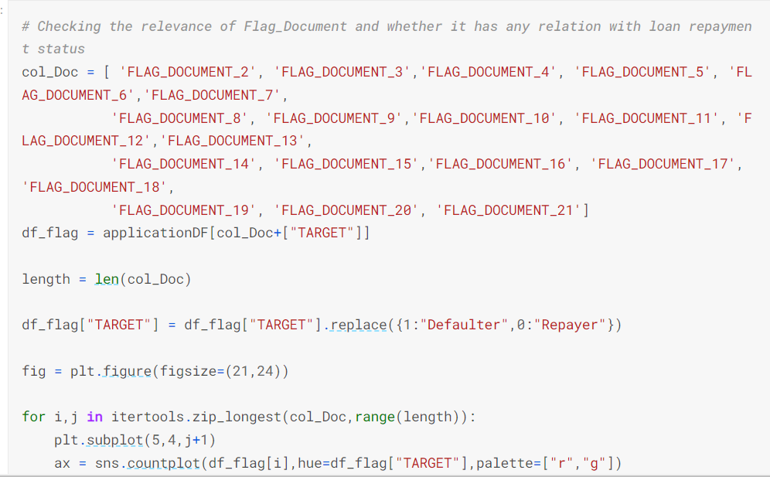
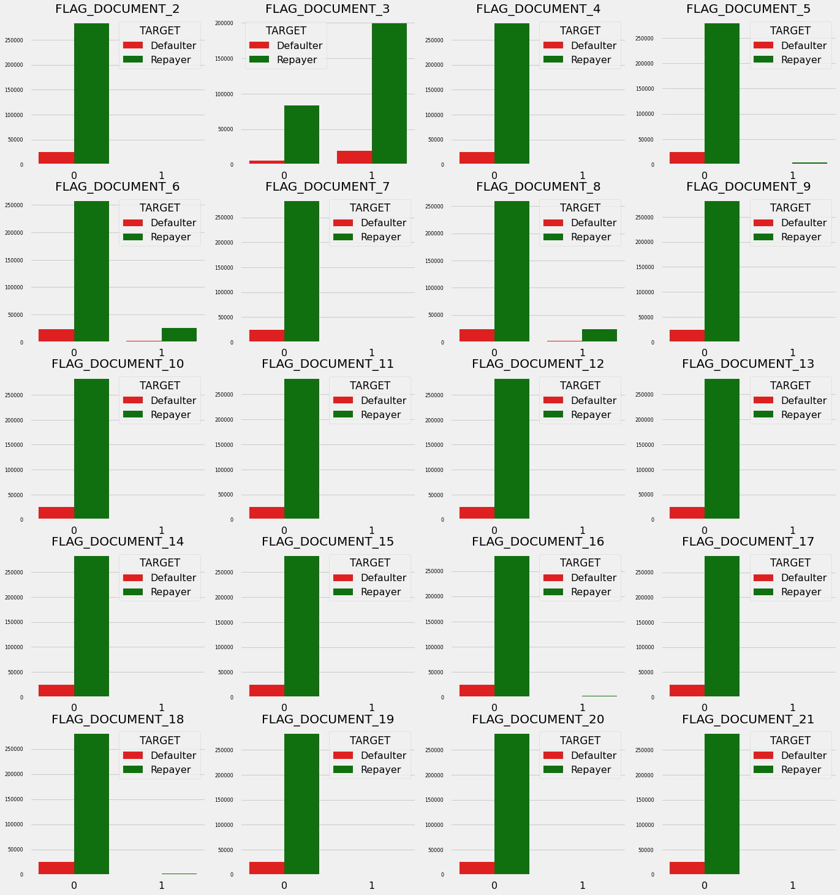
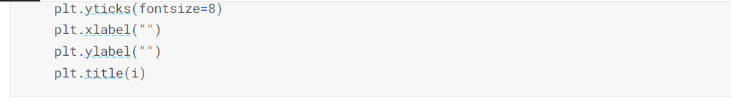
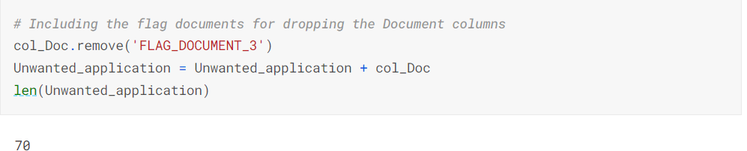
Insight: The above graph shows that in most of the loan application cases, clients who applied for loans has not submitted FLAG_DOCUMENT_X except FLAG_DOCUMENT_3. Thus, Except for FLAG_DOCUMENT_3, we can delete rest of the columns. Data shows if borrower has submitted FLAG_DOCUMENT_3 then there is a less chance of defaulting the loan.

Slide 19
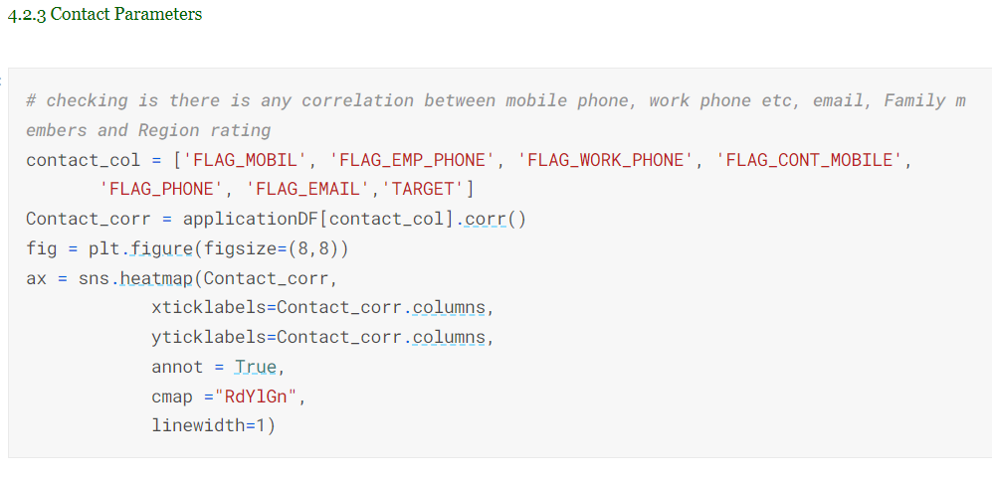
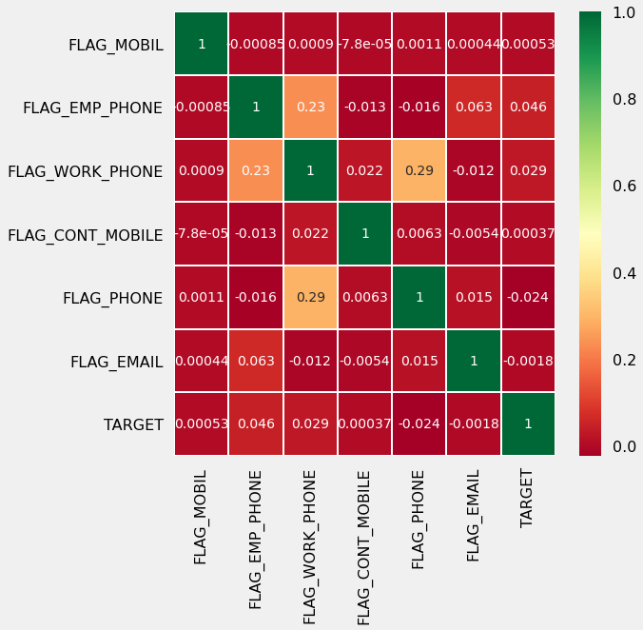
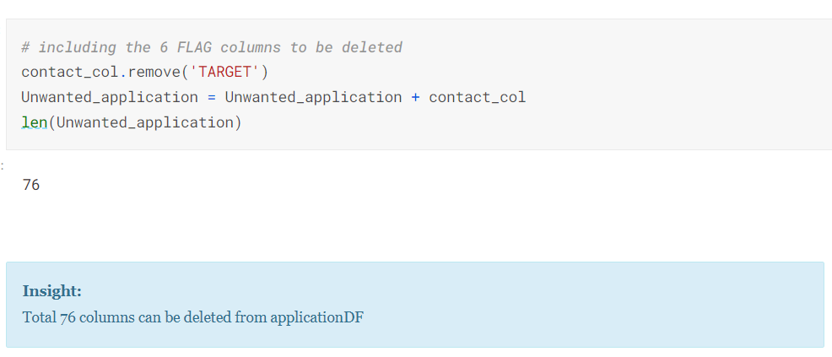
Insight: There is no correlation between flags of mobile phone, email etc with loan repayment; thus these columns can be deleted

Slide 20
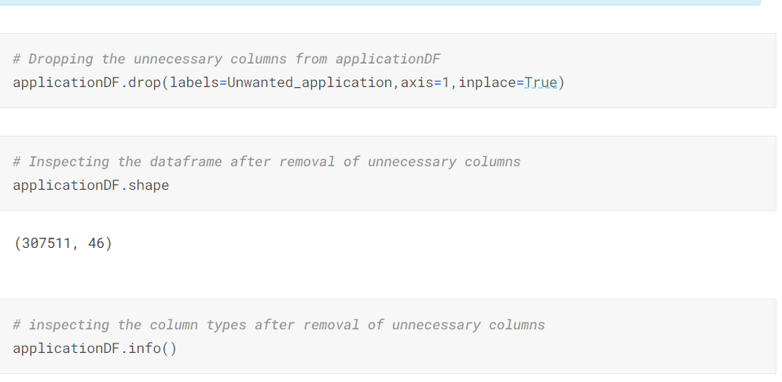
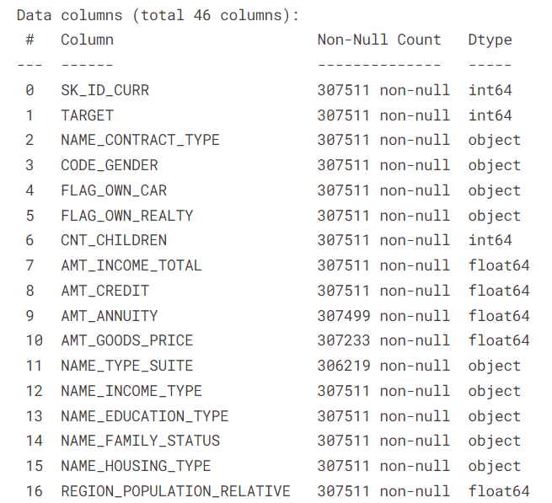
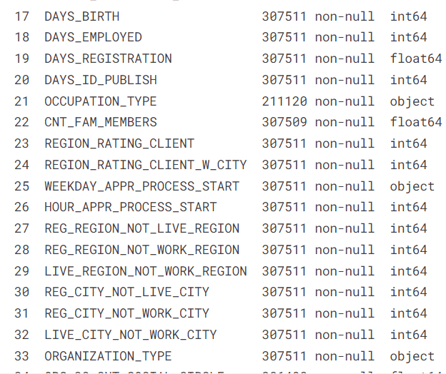
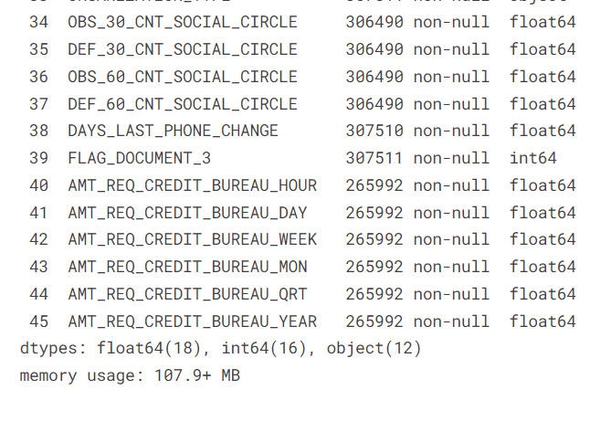

Slide 21
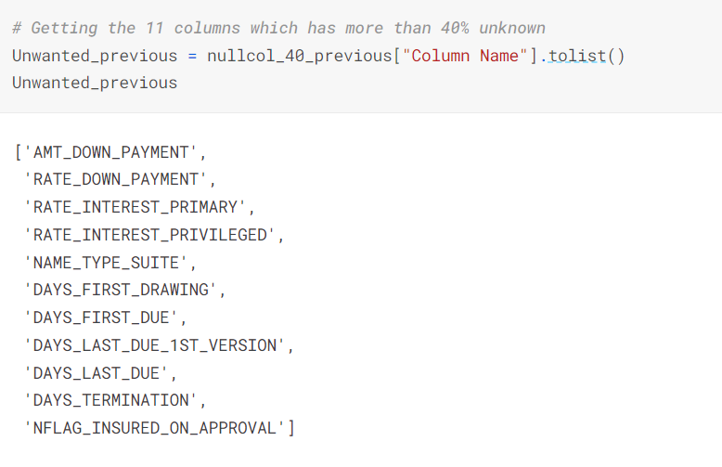
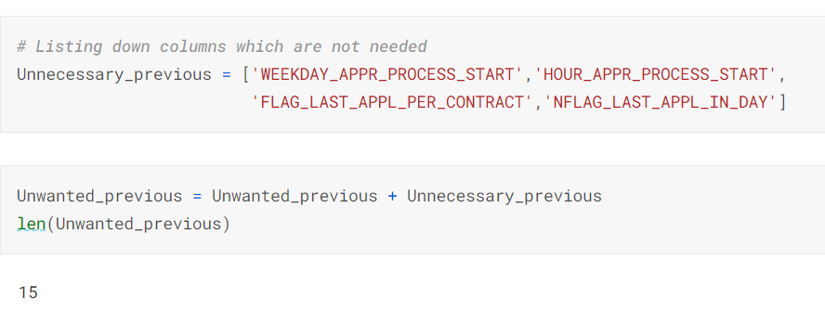
4.3 Analyze & Delete Unnecessary Columns in previousDF:
Insight:
Total 15 columns can be deleted from previousDF.

Slide 22
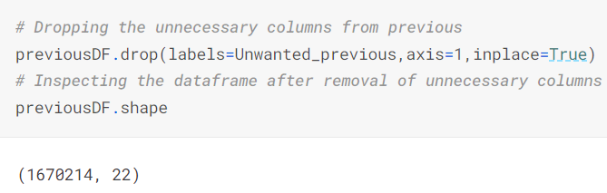
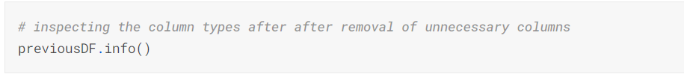
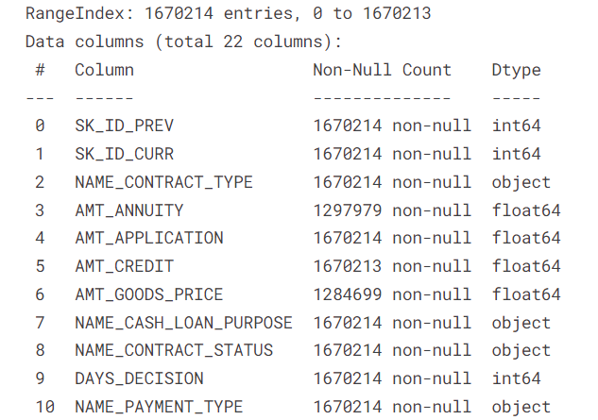
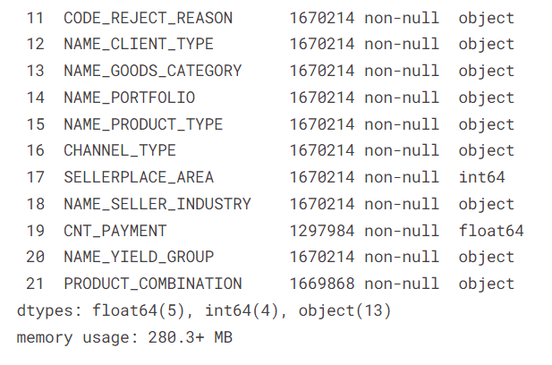
Insight:
After deleting unnecessary columns, there are 22 columns remaining in applicationDF

Slide 23
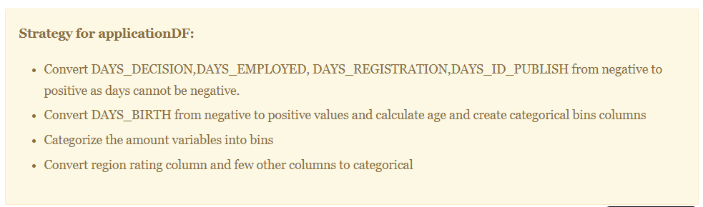
4.4 Standardize Values for applicationDF:
Binning the relevant attribute and find the conclusion :
1.More than 50% loan applicants have income amount in the range of 100K-200K. Almost 92% loan applicants have income less than 300K
2.More than 16% loan applicants have taken loan which amounts to more than 1M.
3.31% loan applicants have age above 50 years. More than 55% of loan applicants have age over 40 years.
4. More than 55% of the loan applicants have work experience within 0-5 years and almost 80% of them have less than 10 years of work experience

Slide 24
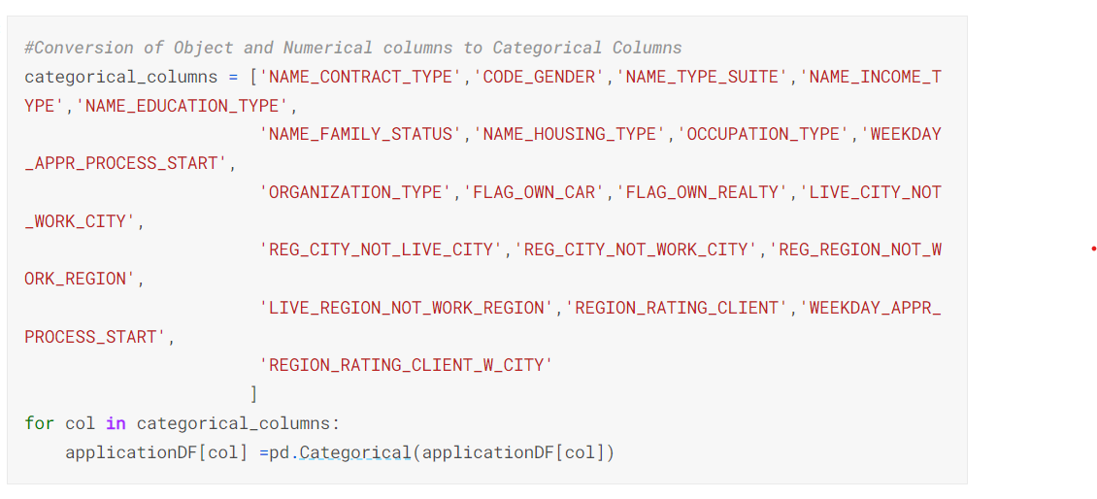
4.5 Data Type Conversion:
Numeric columns are already in int64 and float64 format. Hence proceeding with other columns.
After converting the dtype of column we can check the datatype in each column
dtypes: category(23), float64(18), int64(11)

Slide 25
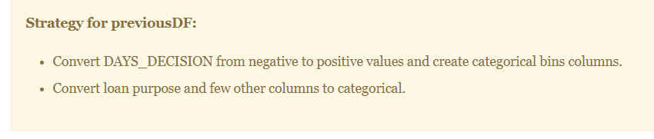
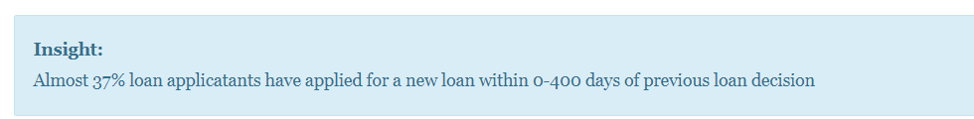
4.4.2 Standardize Values for previousDF :
Converting negative days to positive days
age group calculation e.g. 388 will be grouped as 300-400

Slide 26
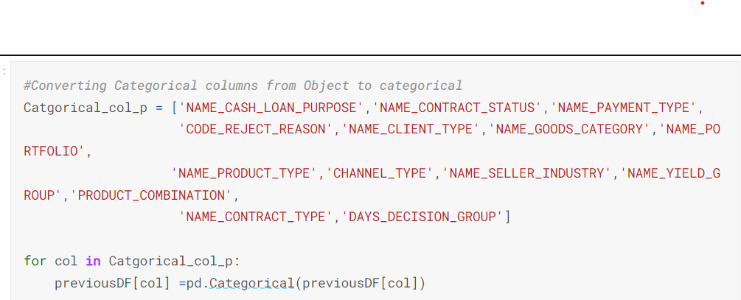
After converting the dtype of column we can check the datatype in each column
dtypes: category(14), float64(5), int64(4)

Slide 27
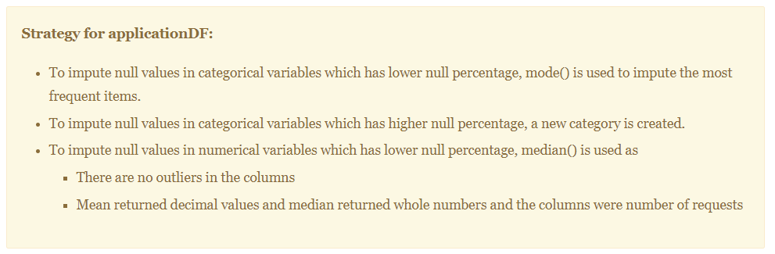
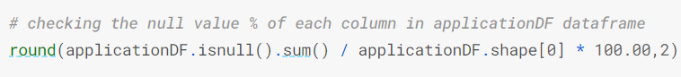
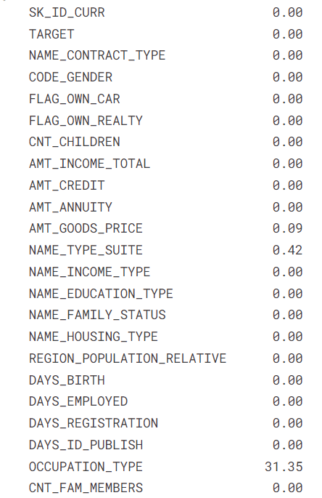
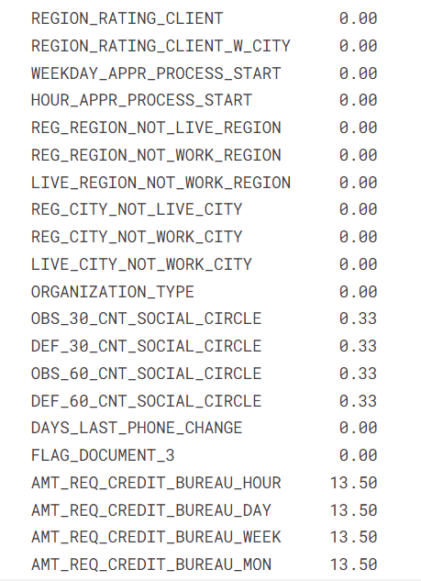
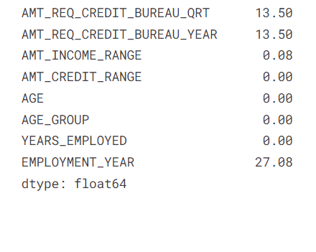
4.6 Null Value Data Imputation :
4.6.1 Imputing Null Values in applicationDF :

Slide 28
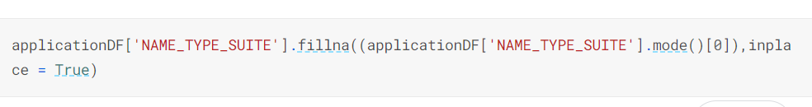
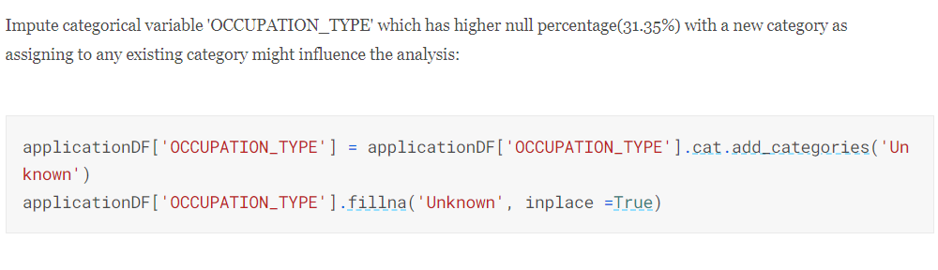

Impute categorical variable 'NAME_TYPE_SUITE' which has lower null percentage(0.42%) with the most frequent category using mode()[0]:

Slide 29





Slide 30





Slide 31





Slide 32





Slide 33



4.7 Identifying the outliers :
Finding outlier information in applicationDF :

Slide 34




Slide 35



5. Data Analysis :
5.1 Plotting Functions :

Slide 36



Slide 37





5.2 Categorical Variables Analysis :
5.2.1 Segmented Univariate Analysis :

Slide 38









Slide 39







Slide 40





Slide 41






Slide 42







Slide 43




Slide 44


5.2.2 Categorical Bi/Multivariate Analysis :

Slide 45


5.3 Numeric Variables Analysis :
5.3.1 Bifurcating the applicationDF dataframe based on Target value 0 and 1 for correlation and other analysis.

Slide 46


5.3.2 Correlation between numeric variable :

Slide 47




Slide 48



Slide 49




Slide 50


7. Conclusions :

Slide 51


Slide 52


